Slide 1





Cryptography and Computer Science
Written by Aidan Majeed

Slide 2
What is Cryptography?
Modern cryptography concerns with:
Confidentiality - Information cannot be understood by anyone.
Integrity - Information cannot be altered.
Non-repudiation - Sender cannot deny his/her intentions in the transmission of the information at a later stage.
Authentication - Sender and receiver can confirm each.
The method of translating ordinary plain text into unintelligible text, and vice versa, is known as cryptography. It is a way of storing and transmitting data in a specific format that can only be read and interpreted by those who are meant to. Cryptography may be used for user authentication as well as shielding data from theft or modification. Cryptography is used in many applications like banking transactions cards, computer passwords, and e- commerce transactions. Cryptography used to be synonymous with encryption, but today it is mostly focused on mathematical theory and computer science practice.
What is a key in Cryptography?
A key is a piece of information (a parameter) that determines the functional output of a cryptographic algorithm.

Slide 3

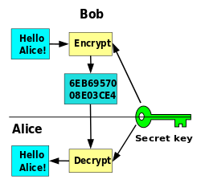
Visual Representation of Cryptography

Slide 4
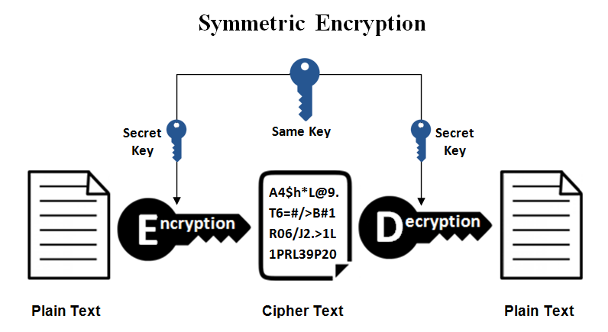
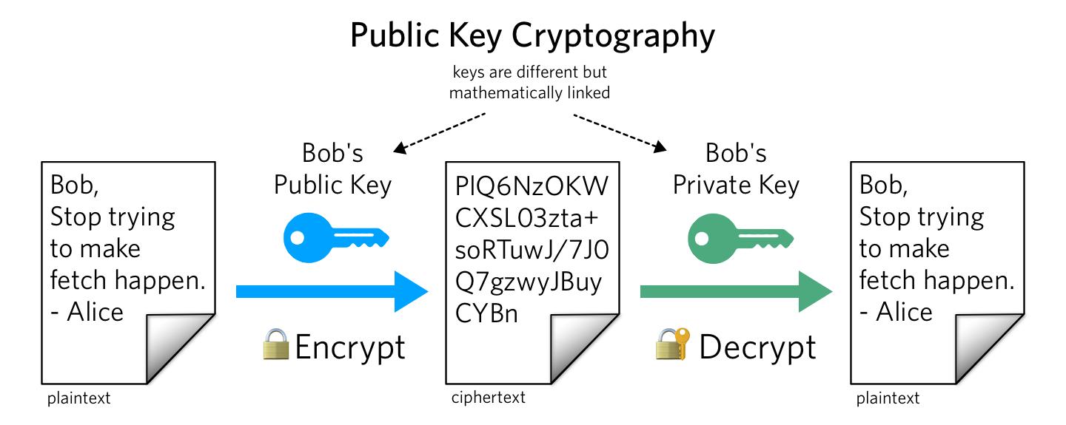
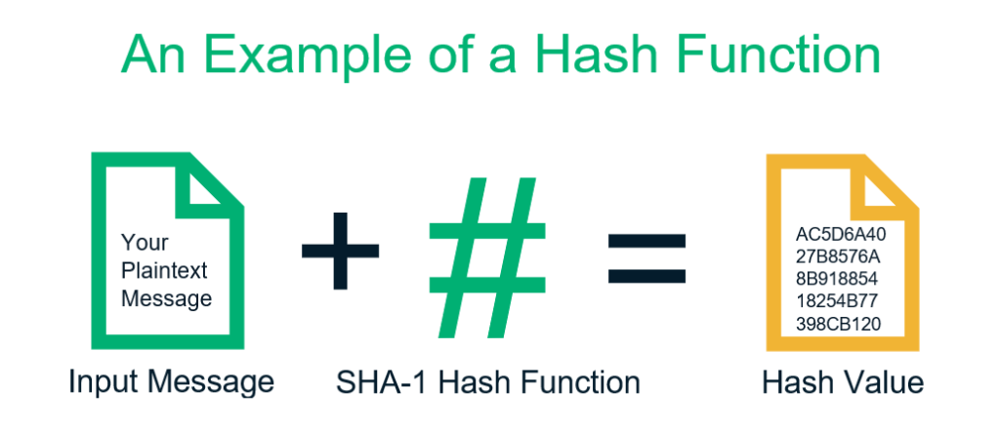
Key Developments in Cryptography
As technology becomes more advanced, Cryptography continues grow. In this field, three modern developments have become well known. These are:
Symmetric-key Cryptography:
A single key is shared by both the sender and the recipient. The sender encrypts plaintext and sends the cypher text to the receiver using this key. The recipient, on the other hand, uses the same key to decrypt the message and retrieve the plain text. However, this is the most unsecured form of cryptography.
Public-Key Cryptography:
The public and private keys are used in public-key cryptography. The public key can be publicly circulated, but the paired private key must be kept secret. The public key is used for encryption, and the private key is used for decryption.
Hash Functions:
This algorithm does not use a key. The plain text is hashed with a fixed-length hash value that prevents the plain text contents from being retrieved. Many operating systems often use hash functions to encrypt passwords.

Slide 5



Cryptography: The More You Know
How Cryptography Evolved
At the end of the 20th century, an upheaval occurred, which involved the way citizens and businesses made use of pure information, meaning information with no physical form. This sparked two technical developments: universal access to affordable real time global communications, and the practical capability to acquire, process, store, and spread unlimited amounts of personal information. This resulted in what we know as electronic banking, personal computers, and e-commerce.
Cryptography and the Military:
Cryptography was initially researched solely for military purposes. During WWII, the encrypted texts were used to send hidden messages. ENIGMA was a common language of cryptography used by the Germans to strike American troops during World War II. Alan Turing was the one who deciphered the code, allowing the US army to avoid losing the war.
A History Lesson:
An inscription carved about 1900 BC in the main chamber of the tomb of the nobleman Khnumhotep II in Egypt was the first recorded evidence of the use of cryptography (in some form). In place of more common hieroglyphic symbols, the scribe used some unusual ones. The aim wasn't to conceal the message, but rather to alter its appearance to make it look more dignified.

Slide 6

Computer Science Behind Cryptography
As mentioned before, Cryptography involves encryption methods, two of which being Symmetric-Key Cryptography, and Public-Key Cryptography. However, each call for different algorithms upon creation.
Symmetric-Key Cryptography can be created within the Python programming language via packages, and utilizes a Data Encryption Standard algorithm, commonly referred to as DES.
The DES algorithm, created in the 1970s, is a symmetric-key block cipher, and takes plain text in 64- bit blocks, and in turn converts them into cipher text using 48-bit keys. Another variant of DES, known as triple DES is used, where it encrypts with the first key, decrypts using the second key, then encrypts with the third key. However, due to the fact that these keys can be accessed by almost everyone, DES is not used as much anymore.
Public-Key Cryptography can also be created within python via packages, but utilizes the RSA algorithm.
Under the RSA encryption, messages are encrypted with the public-key code, and due to distinct mathematical properties within this algorithm, once the message is encrypted, it can only be decrypted with another privatized key.
These distinct and complex mathematical properties are known as trapdoor functions, generating primes, Carmichael’s totient function, which are involved in computing the public and private keys used in the encryption and decryption processes.
The DES algorithm process breaks down into the following steps:
The process begins with the 64-bit plain text block getting handed over to an initial permutation (IP) function.
The initial permutation (IP) is then performed on the plain text.
Next, the initial permutation (IP) creates two halves of the permuted block, referred to as Left Plain Text (LPT) and Right Plain Text (RPT).
Each LPT and RPT goes through 16 rounds of the encryption process.
Finally, the LPT and RPT are rejoined, and a Final Permutation (FP) is performed on the newly combined block.
The result of this process produces the desired 64-bit ciphertext.

Slide 7


What is the Future Cryptography?
It is believable that Cryptography will continue to evolve and grow so that the public’s data remains secure and stable. This can include service and platform providers creating efficient ways to secure and encrypt user information to a further degree than it is today. Despite this, the fact that digital communication, and digital cash, such as cryptocurrency, are becoming more common, it is also extremely plausible that those who break cryptographic systems, such as hackers, will become more prominent. This can lead to a an abundance of valuable information becoming at risk of being stolen. However, for the future, the only certainty is that cryptography will never be 100% flawless and will still continue to develop. With this people must accept the fact that there are risks involved.

Slide 8
Resources
https://economictimes.indiatimes.com/definition/cryptography
https://marvelous-essays.com/blog/interesting-facts-about-cryptography.html
https://www.britannica.com/topic/cryptology
https://www.simplilearn.com/what-is-des-article
https://www.comparitech.com/blog/information-security/rsa-encryption/

